Slide 1



Speech Emotion Recognition (SER)
END TERM PRESENTATION
Under The Guidance Of
Ms. Neha V Sharma
Department of Information Technology
School of Information Technology
2022-2023
By – Dev Beniwal Reg no. - 209302060

Slide 2


Contents Of Presentation
1. Introduction 2. Motivation 3. Applications 4. Proposed Methodology 5. Software/Hardware Requirements 6. Implementation 7. Conclusion 8. References

Slide 3
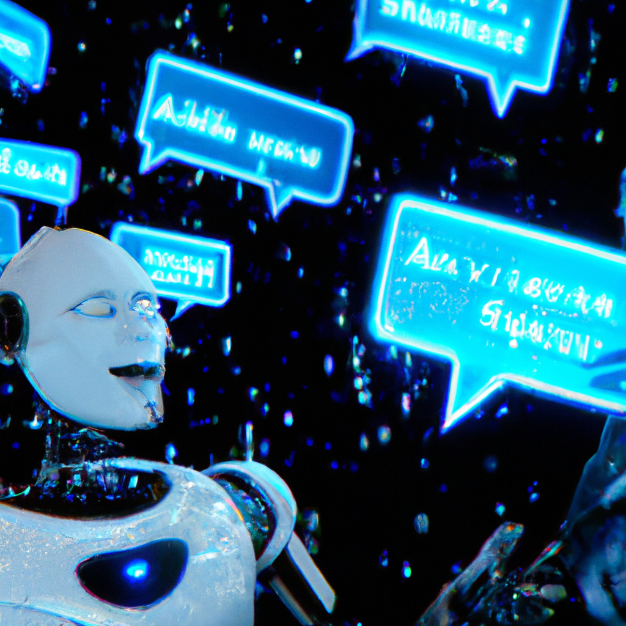
Introduction
Speech is an important medium of communication between humans. It conveys not only the information but also the emotions and intentions behind it. Emotion recognition from speech has been a topic of interest in recent years, as it has potential applications in various fields such as healthcare, education, and entertainment.
Speech Emotion Recognition (SER) is a field of research that focuses on recognizing emotions from spoken language. In this project, we propose a machine learning-based approach for SER using the TESS dataset. My proposed model utilizes various speech features and machine learning algorithms to recognize emotions from speech signals.

Slide 4
Motivation
There are several motivations for building a speech emotion recognition project, including:
Improving human-computer interaction: By recognizing and responding to the emotional state of the speaker, machines can provide more natural and intuitive interfaces, making it easier for people to communicate with computers and devices.
Enhancing user experience: By recognizing and responding to the emotional state of the user, machines can personalize their responses and tailor their interactions to the user's needs, preferences, and emotional state.
Improving accessibility: For individuals with communication difficulties or disorders, such as autism, recognizing emotions from speech signals can help them express their emotions more effectively and communicate more easily.
Advancing research in psychology and neuroscience: Speech emotion recognition can provide insights into the nature of human emotions, the relationship between emotions and language, and the neural mechanisms involved in emotion processing.
Enabling better analysis of media content: Recognizing emotions from speech signals can help analyze the emotional content of media, such as movies, music, and social media, for applications such as sentiment analysis and recommendation systems.
Overall, the motivation for building a speech emotion recognition project is to create more intelligent and responsive machines that can understand and respond to human emotions, which can improve communication, accessibility, and user experience, and advance research in psychology and neuroscience.

Slide 5
Applications
The speech emotion recognition project has various potential applications in different fields. Some of the applications are:
Human-Computer Interaction: Speech emotion recognition can be integrated into devices such as smartphones, laptops, and home automation systems to enhance human-computer interaction. For instance, speech emotion recognition technology can be used to analyze and recognize user emotions and adjust the device settings accordingly. This can lead to better user experience and satisfaction.
Healthcare: The technology can also be used in healthcare to monitor and diagnose mental health conditions such as depression, anxiety, and PTSD. The use of speech emotion recognition in healthcare can aid in early detection and treatment of these mental health conditions.
Marketing: In the field of marketing, speech emotion recognition can be used to analyze customer emotions and behavior towards a product or service. This can be useful in improving marketing strategies, enhancing customer experience, and increasing sales.

Slide 6

Education: The technology can also be used in education to assess student engagement and motivation levels during learning. This can aid in developing personalized learning approaches for students.
Entertainment: Speech emotion recognition technology can be integrated into gaming systems to create more immersive and engaging gaming experiences. The technology can also be used to create personalized recommendations for users based on their emotional responses to different types of media.
Overall, speech emotion recognition technology has wide-ranging potential applications in various fields, and the development of accurate and reliable models can lead to significant benefits in different areas.

Slide 7
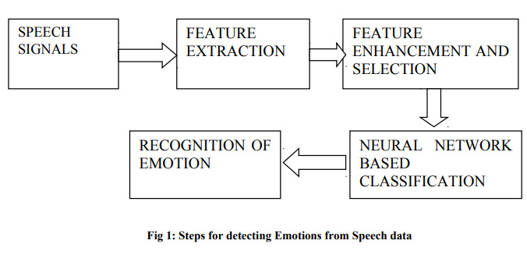
Basic representation of how SER works

Slide 8
Proposed Methodology
The proposed model for speech emotion recognition consists of :
Data Collection: Collect a dataset of audio recordings of human speech that contains different emotions such as happy, sad, angry, and neutral. You can use public datasets like TESS, SAVEE, or create your own dataset. For my SERS I have used the TESS dataset which has set of 200 target words which were spoken in the carrier phrase "Say the word 'by two actresses (aged 26 and 64 years) and recordings were made of the set portraying each of seven emotions (anger, disgust, fear, happiness, pleasant surprise, sadness, and neutral). There are 2800 data points (audio files) in total.
Data Preprocessing: Convert the audio recordings to Mel Frequency Cepstral Coefficients (MFCCs) using a library such as librosa. MFCCs are a standard audio feature used in speech recognition tasks. You may also want to perform some audio preprocessing steps such as noise removal and audio normalization.
Data Partitioning: Split your dataset into training, test sets.
Model Development: Develop an LSTM model using a deep learning library such as Keras or PyTorch. An LSTM (Long Short-Term Memory) model is a type of machine learning algorithm that can process sequential data like text or speech. It is a type of neural network that has special memory cells that can store information for a long time. These memory cells are controlled by three gates that decide what information to keep, what information to forget, and what information to output. By using these gates, an LSTM model can selectively store and retrieve information from memory cells, allowing it to learn long-term patterns in the sequential data. LSTM models have been very successful in various applications, including speech recognition, natural language processing, and video analysis.

Slide 9
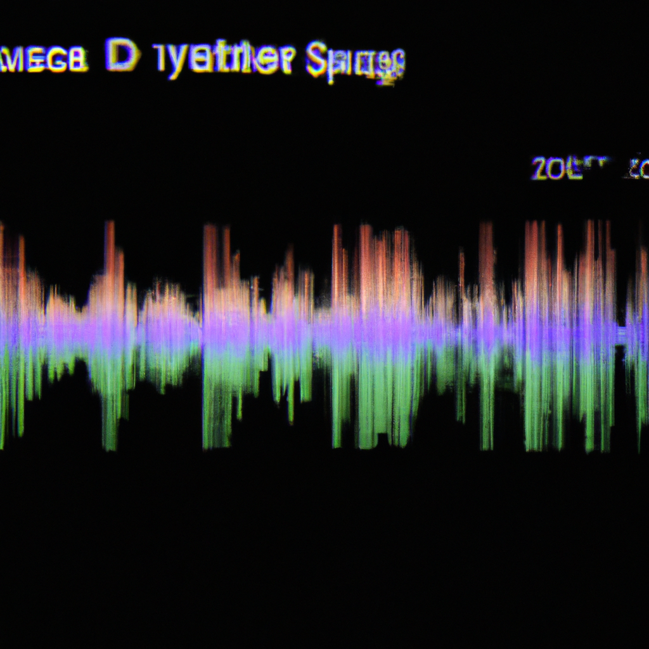
Model Training: Train the LSTM model on the training set using an appropriate loss function and optimization algorithm. You can experiment with different hyperparameters such as learning rate, batch size, and number of epochs to find the best combination.
Model Evaluation: Evaluate the performance of the trained model on the test set using metrics such as accuracy, precision, recall, and F1 score. You can also visualize the performance using a graphical representation.
Model Deployment: Once you are satisfied with the performance of your model, you can deploy it in a production environment. You can use a web application or an API to make predictions on new audio recordings.

Slide 10
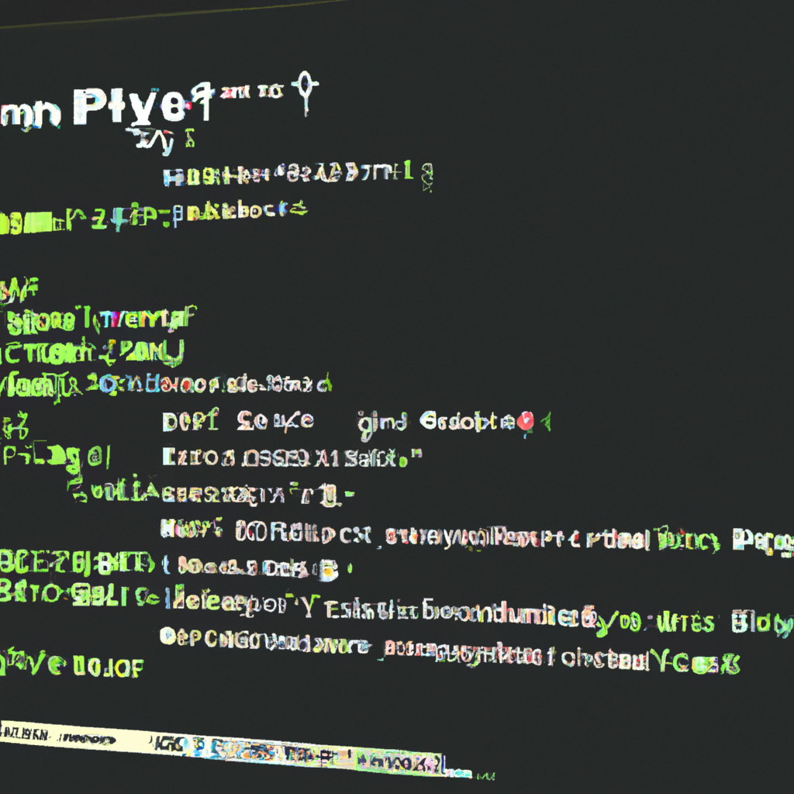
Software/Hardware Requirements
Software Requirements
Python 3
Librosa library for audio feature extraction
Scikit-learn library for machine learning algorithms
Jupyter Notebook for code development and analysis
Hardware Requirements
A computer with a multi-core CPU, 8GB RAM or more, and 500GB or more Hard Disk space.

Slide 11
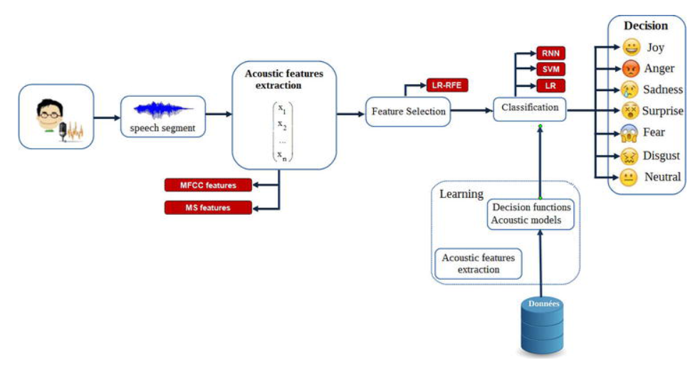

Slide 12
Implementation
The implementation of SER using machine learning involves the following steps:
3.1 Dataset Selection:
The first step is to select an appropriate dataset for training and evaluation. The commonly used datasets for SER include the RAVDESS, TESS, and SAVEE datasets. These datasets contain audio recordings of actors expressing different emotions.
For this project, we’ll use the TESS dataset; Toronto Emotional Speech Set ,There are set of 200 target words were spoken in the carrier phrase "Say the word 'by two actresses (aged 26 and 64 years) and recordings were made of the set portraying each of seven emotions (anger, disgust, fear, happiness, pleasant surprise, sadness, and neutral). There are 2800 data points (audio files) in total.
The dataset is organized such that each of the two female actor and their emotions are contain within its own folder. And within that, all 200 target words audio file can be found. The format of the audio file is in WAV format.

Slide 13
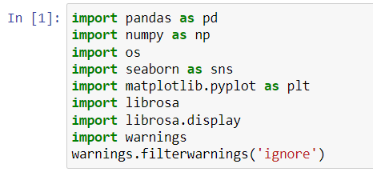
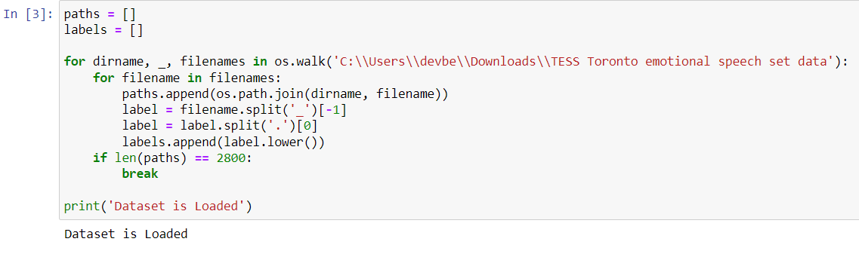
First of all we have imported some libraries:
The first five i.e pandas, numpy, os, seaborn, and matplotlib are for visualization purpose. Now to import the audio files we have used the Librosa and Librosa.display.
if you want to play the audio means we have to import the ipython.display,import audio To ignore the warnings we are using warnings.filterwarnings(‘ignore’)
The file paths and labels are loaded from the TESS dataset. The code loops through the directory tree using os.walk() and appends the file paths and labels to two lists. The if statement ensures that only the first 2800 files are loaded.
Using paths and labels we have created two lists and by these lists we will create dataframe by adding everything into the list.
Label.append will move the labels to the label list

Slide 14
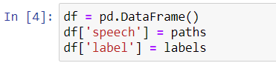
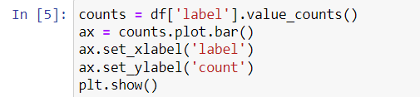
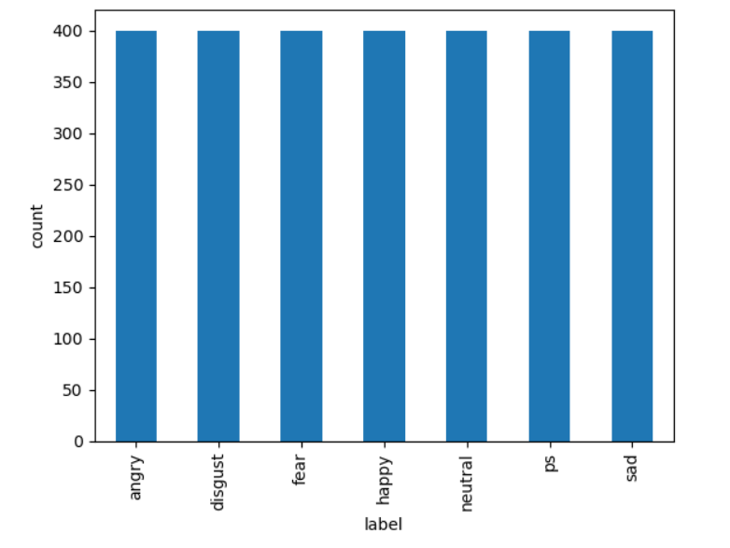
Here we have created a data frame for paths and labels.
The total no samples use for each emotion i.e fear, anger ,disgust, neutral, sad, ps ,and happy are 400. Total 2800 samples.
The label counts are plotted using the Pandas value_counts() method and the plot.bar() function from matplotlib.
Output using matplotlib in a graphical representation. Where x-axis are the emotions which will be tested and the model will be trained on. And on the y-axis we have the count or the number of times these emotions appeared in the dataset.

Slide 15
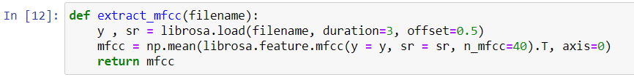
3.2 Feature extraction:
Feature extraction is the process of extracting various acoustic features of the speech which can directly affect the accuracy of the classification results, acoustic features include physical aspects of spoken language that can be recorded and analyzed these include waveform analysis, FFT or LPC analysis, voice onset time , format frequency, measurements and so on.
We are using the MFCC method in our model for the process of feature extraction.
So Mel Frequency Cepstral Coefficient ( MFCC ) is basically one of the methods used to extract the various acoustic features of a speech from a raw data to perform various things on the extracted data which can be further used for the classification of the emotions of a speech.
A function called extract_mfcc() is defined to extract MFCC (Mel-frequency cepstral coefficients) features from an audio file. It loads an audio file using librosa.load(), then extracts the MFCCs using librosa.feature.mfcc() and takes the mean across the time axis.

Slide 16
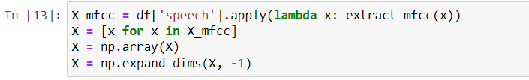
The MFCC features are extracted from all the audio files in the dataframe using apply() and the extract_mfcc() function. The resulting MFCC arrays are appended to a list, which is then converted to a NumPy array of shape (2800, 40). The array is then expanded along a new dimension using np.expand_dims(), resulting in a final shape of (2800, 40, 1).
The labels are converted from strings to integers using a dictionary called label_dict. The integers are then converted to one-hot encoded arrays using np.eye().

Slide 17
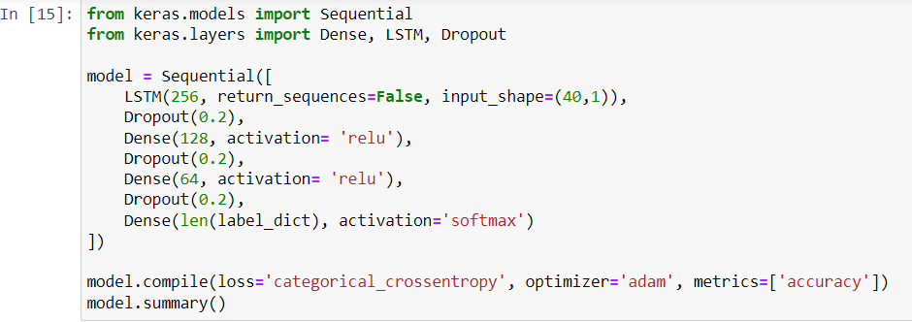
3.3 Implementing the Model
For creating the LSTM model we have to import the sequential, dense, LSTM and the dropout form keras.models and keras.layers respectively.
Then specifying the various values required.
In the next step compiling the model for loss and accuracy and then model.summary() to view the model it will look something like this.
A LSTM model is defined using the Keras Sequential API. It consists of four layers: an LSTM layer with 256 units, a dropout layer with a rate of 0.2, a dense layer with 128 units and ReLU activation, another dropout layer, a dense layer with 64 units and ReLU activation, another dropout layer, and a final dense layer with softmax activation to output the probabilities of the different classes. The model is compiled using categorical cross-entropy loss, the Adam optimizer, and accuracy as the metric.

Slide 18
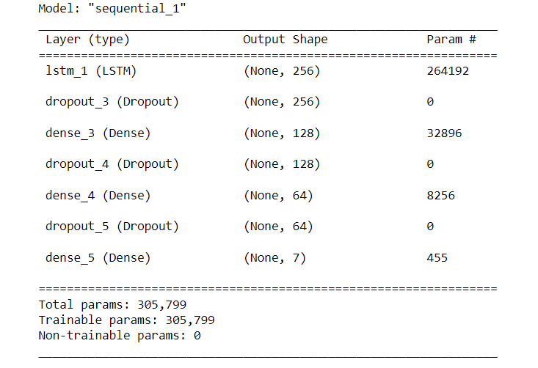
Output Of the LSTM model.

Slide 19
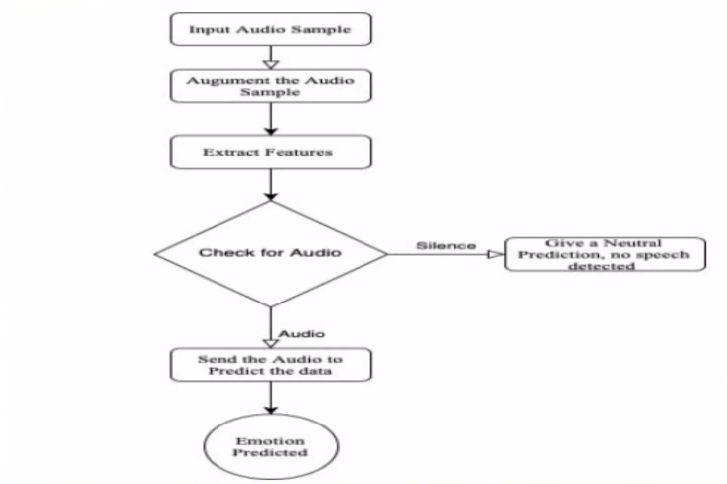
Training Process Workflow

Slide 20
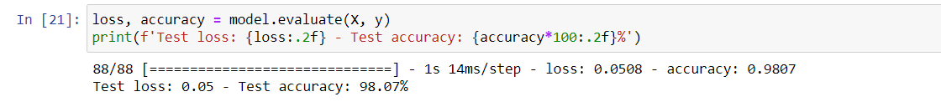
Training the model
Validation split = it will do the splitting for us.
Epochs = the number of complete passes through the complete dataset. Batch size= the number of training examples utilized in one literaion.
Emotions Recognized
As we can see from this screenshot my model recognized the testing dataset at the accuracy of 98.07%.
A detailed explanation will be given in the next section below.

Slide 21
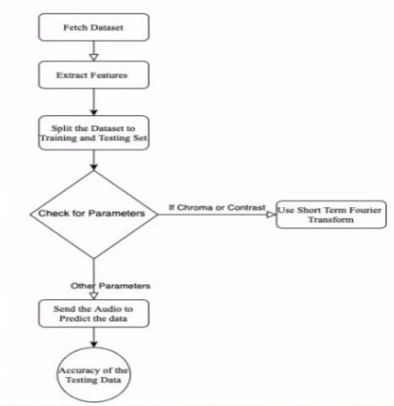
Testing Process Workflow

Slide 22
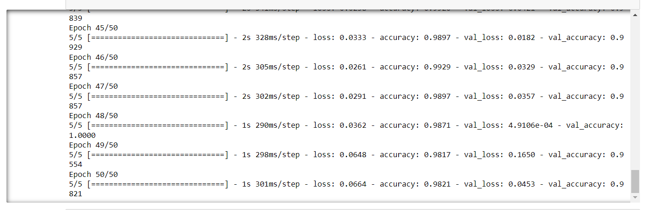
This is the output for 50 samples after testing the model.

Slide 23
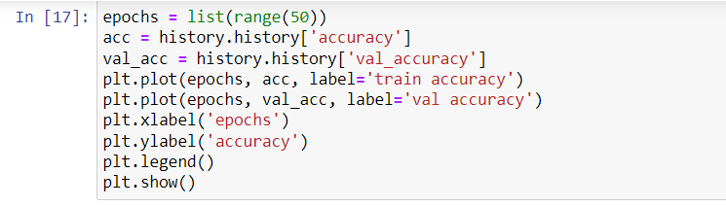
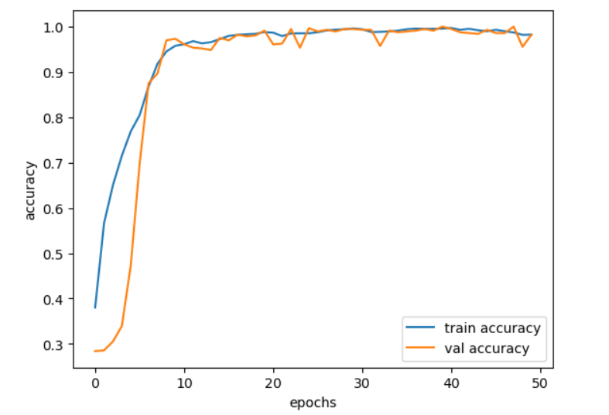
Code to visualize the accuracy of the model using matplotlib library.
Output of the code to visualize the accuracy of the model in a graphical manner.

Slide 24
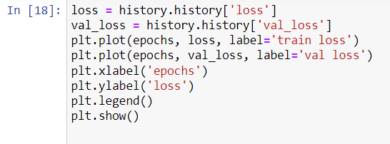
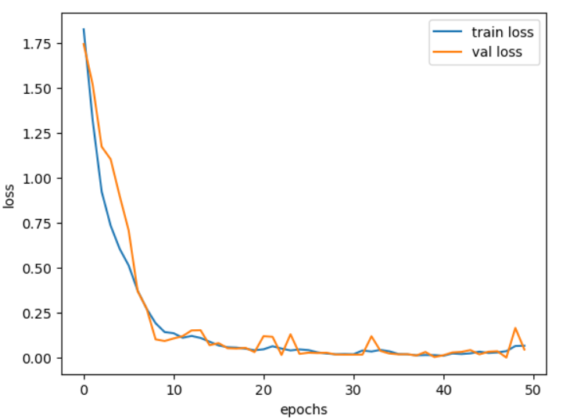
Code to visualize the loss of the model using matplotlib library.
Output of the code to visualize the loss of the model after training in a graphical manner.

Slide 25
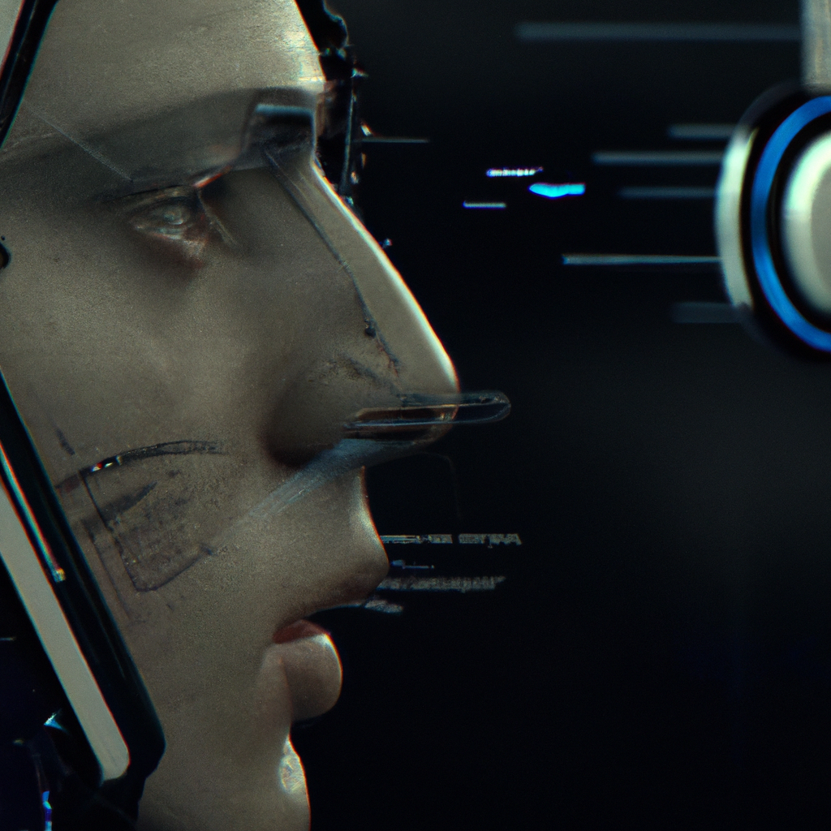
Conclusion and Future Work
Speech Emotion Recognition using machine learning is a challenging task due to the complexity and variability of human emotions. However, by using various speech features and machine learning algorithms, we can achieve high accuracy in recognizing emotions from speech signals. In this project we have tried to analyze some samples of speech using the machine learning technique. Firstly we loaded the datasets. Then we extracted the acoustic features of all our samples using the MFCC method and arranged the sequential data obtained in the 3D array form as accepted by the LSTM model. Then we build the LSTM model and after training the model.
I visualized the data into the graphical form using matplotlib library and after some repeated testing using different values the average accuracy of the model is found to be 98%.
I am going to use RAVDESS and SAVEE dataset along with existing Dataset to increase the accuracy of the model. Planning to work on CNN and Tensorflow for future iteration of model and increase functionality and precision.

Slide 26
References
https://www.analyticsinsight.net/speech-emotion-recognition-ser-through-machine-learning/
https://www.researchgate.net/publication/330383935_A_Literature_Review_on_Emotion_Recognition_Using_Various_Methods
https://www.researchgate.net/publication/225359641_Towards_Emotion_Recognition_from_Speech_Definition_Problems_and_the_Materials_of_Research
Liberman, Mark, et al. Emotional Prosody Speech and Transcripts LDC2002S28. Web Download. Philadelphia: Linguistic Data Consortium, 2002.
IEEE Research Paper 12 https://ieeexplore.ieee.org/document/7344793/?reload=true
M.M.H.E. Ayadi, M.S. Kamel, F. Karray, "Survey on speech emotion recognition: Features classification schemes and databases", Pattern Recognition, pp. 572-587, 2011.
https://www.kaggle.com/datasets/uwrfkaggler/ravdess-emotional-speech-audio?resource=download

